Slide 1
Enthalpy – theoretical values
11 Chemistry

Slide 2
Learning objectives
• Calculate the enthalpy change (ΔH) for a reaction given temperature changes, quantities of reactants and mass of water. (Formula: ΔH = H(products) – H(reactants))

Slide 3
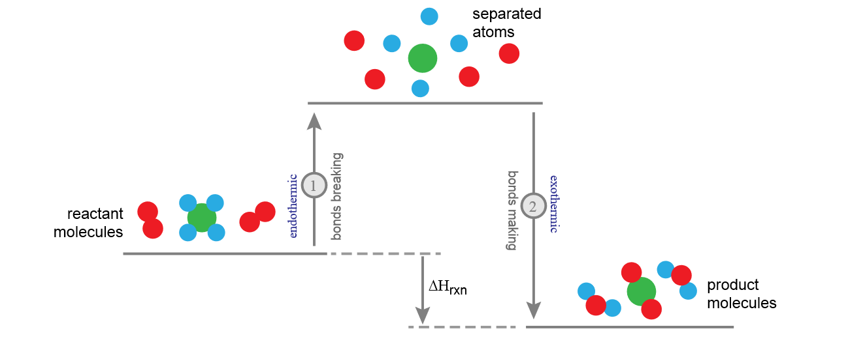
What’s going on at a molecular level…
𝐻= Σ(bonds broken) – Σ(bonds formed)

Slide 4
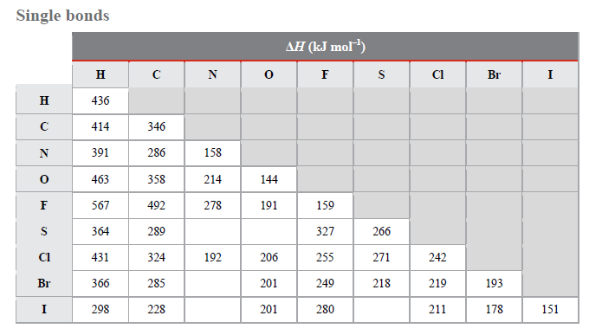
What’s going on at a molecular level…
This is the amount of energy in a carbon-hydrogen bond
Chemical reactions involve the forming and breaking of bonds to make new substances, and in these bonds is stored Chemical Potential Energy.
This Chemical bond energy = bond enthalpy is the net sum of the attractive and repulsive electrostatic interactions between electrons and nuclei.
i.e. the amount of energy required to break 1 mole of the bond into separated atoms.
Bond enthalpy is measured in the gas phase in kJ/mole
This table is in your data booklet – page 8!

Slide 6
What’s going on at a molecular level…
This is the amount of energy in a carbon-hydrogen bond
If we know the amount of energy stored in the bonds of the products and reactants, we can also calculate the enthalpy of a reaction:
ΔH = ∑bonds broken - ∑bonds formed
We can therefore use the table to the left to calculate the enthalpy of a reaction just by looking at the bonds which are made/broken (see next slide)
This symbol is called sigma. It means “sum of” (i.e. add together the enthalpy of all bonds broken in a reaction)
This table is in your data booklet – page 8!

Slide 7
Example
E.g. CH_{4(g)} + 2O_{2(g)} → CO_{2(g)} + 2H₂O_{(l)}
Bonds Broken: Bonds Formed:
4x C-H bonds 4x 414 2x C=O 2x 804
2x O=O 2x 498 2x H-O, x2 molecules 4x 463
2652 3460
ΔH = ∑bonds broken - ∑bonds formed = 2652 – 3460 = -808kJ/mole (and extra 82kJ/mole to turn 2H₂O_{(l)} into 2H₂O_{(g)}).

Slide 8
LIMITATIONS OF BOND Enthalpy calculations
Calculated values often deviate from experimental values.
Due to calculations being based on average bond enthalpy values – do not take variations into account.
Factors that can influence actual bond enthalpy:
Inductive effect – atoms with high electronegativity in the molecule pull electrons away from atoms with low electronegativity. This can occur across multiple bonds. Results in bonds becoming weaker/stronger.
Steric factors – strain caused by bonds being forced into an unnatural orientation. Results in weaker bonds.
Delocalisation of electrons – electrons shared between bonds. Results in electrons being shared across single and double bonds (enthalpy values for single and double bonds in these situations will be incorrect).

Slide 9
Check for Understanding
Don’t forget to check the data booklet – it’s in the assessment tab of the Onenote!
Calculate the reaction enthalpy for the combustion of ethane (you will need to balance it first!) shown below:
C₂H_{10 (g)} + O_{2 (g)} → CO_{2 (g)} + H₂O _{(l)}

Slide 10
Your turn
H_{2(g)} + Cl_{2(g)} → 2HCl_{(g)}
1. Determine whether the reaction is endothermic or exothermic.

